Slide 1
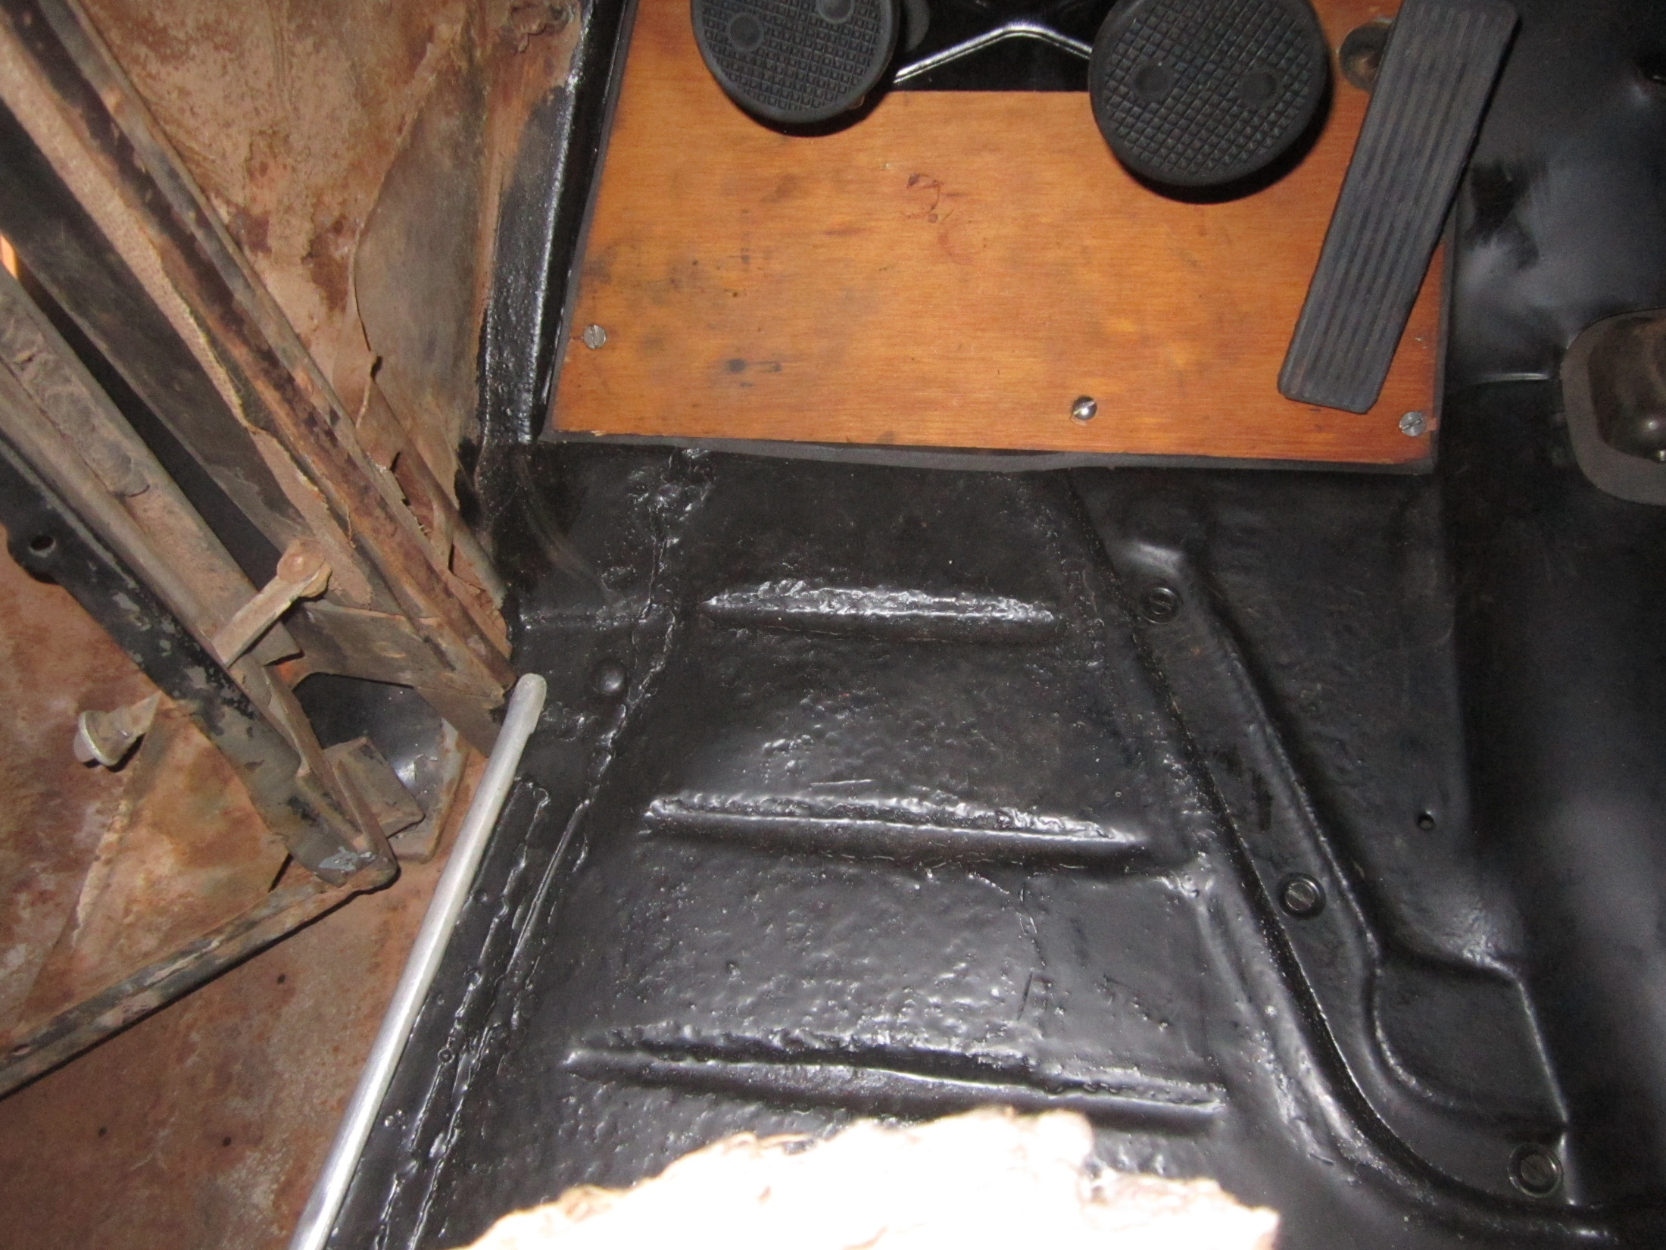
Floormat tucked up underneath scuff plate edge???

